Slide 1
Chapter 2 The mathematical building blocks of neural networks
2026 Fall
조상구교수

Slide 2
Goals
This chapter covers
High-level definitions of fundamental concepts
A soft introduction to the principles behind machine learning
Deep learning’s rising popularity and future potential

Slide 3

A first look at a neural network
MNIST sample digits

Slide 4

A geometric interpretation of deep learning
Uncrumpling a complicated manifold of data

Slide 5
The engine of neural networks: Gradient-based optimization
output = relu(matmul(input, W) + b)
W and b are tensors that are attributes of the layer. They’re called the weights or trainable parameters of the layer (the kernel and bias attributes, respectively). These weights contain the information learned by the model from exposure to training data.

Slide 6

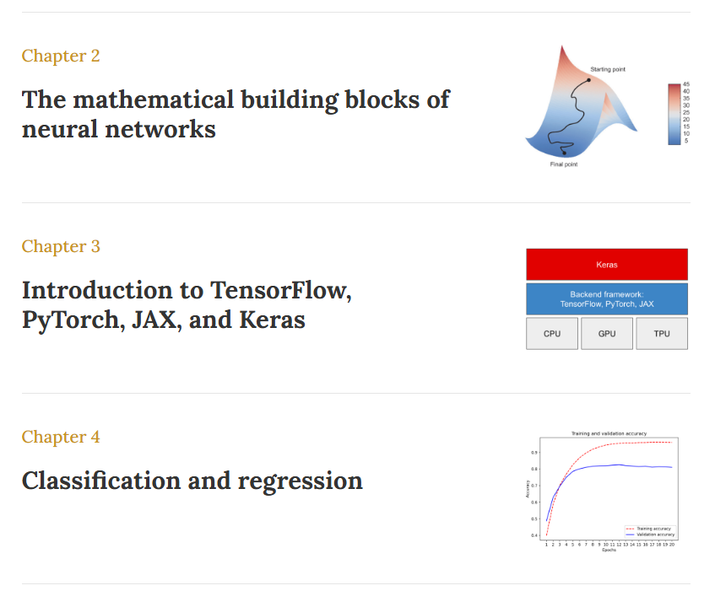

Exercise
본문만 읽기
(선형대수,
Linear Algebra)
Pytorch 만 실습
Full 실습

